Slide 1

Objectives
On completion of this unit, you should be able to:
Discuss the nature of creativity and innovation and their role in entrepreneurship
Describe the steps in the creative process
Explain how entrepreneurs can enhance their own creativity
Identify the four major types of innovation
Discuss some of the sources of innovation for entrepreneurs, and identify some of the major myths and discuss the principles of innovation.

Slide 2
Creativity, innovation and entrepreneurs
Creativity is thinking new things, and innovation is doing new things
Creativity is the ability to develop new ideas and to discover new ways of looking at problems and opportunities.
Innovation is the ability to apply creative solutions to those problems and opportunities in order to enhance people’s lives or to enrich society
Entrepreneurship = creativity + innovation

Slide 3
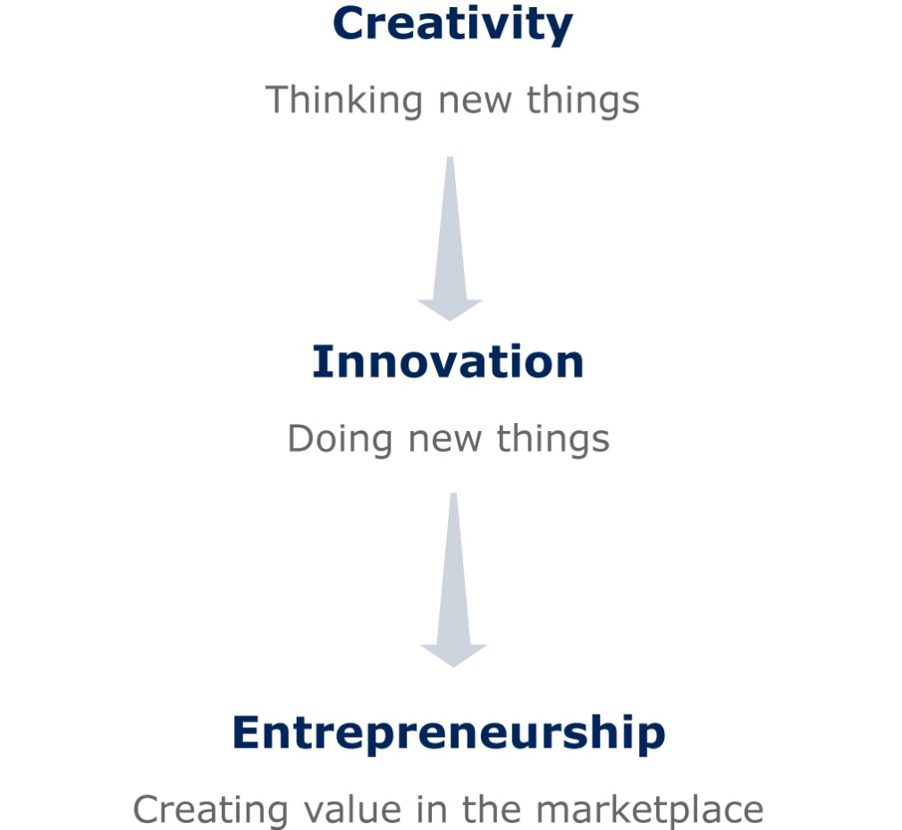
From Creativity to Entreprenurship

Slide 4
Creativity, innovation and entrepreneurs
Creativity is the ability to develop new ideas and to discover new ways of looking at problems and opportunities.
Innovation is the ability to apply creative solutions to those problems and opportunities in order to enhance people’s lives or to enrich society.
Researchers believe that entrepreneurs succeed by thinking and doing new things or old things in new ways .

Slide 5
Creativity, innovation and entrepreneurs
Entrepreneurship is the result of a disciplined, systematic process of applying creativity and innovation to needs and opportunities in the marketplace.
New ideas are much more than just random, disjointed tinkerings with a new gadget.
Entrepreneurs are those who marry their creative ideas with the purposeful action and structure of a business.

Slide 6
Creativity
There are four phases which can help to remove ‘idea blocks’ to and enhance creative thinking.
The four phases with their important activities are as follows:
1: background or knowledge accumulation e.g. reading, professional conferences, talking, visit to library
2: incubation process e.g. ‘sleep on it’, exercise,
3: idea or ‘eureka’ experience, usually this phase slowly but surely formulates the solution
4: evaluation and implementation e.g. prototypes, advice.

Slide 7
Creativity
Characteristics of successful entrepreneurs generally include a positive self-image, being motivated by challenging problems, being sensitive to the world around them, and being good at gathering different ideas in a short amount of time.
It is not necessary to possess all of these characteristics to be successful.
Developing creativity is a process of changing the way you look at things. To do this you must look for different or unorthodox relationships between people and things.
Another way to be more creative is to view people and things in terms of how they can be used to satisfy needs (both as resources and problem solvers).

Slide 8
Creativity
The following questions are designed to spur the imagination and can help develop creativity:
1. Is there a new way to do it?
2. Can you borrow or adapt it?
3. Can you give it a new twist?
4. Do you merely need more of the same?
5. Do you just need less of the same?
6. Is there a substitute?
7. Can the parts be rearranged?
8. What if we do just the opposite?
9. Can ideas be combined?
10. Can we put it to other uses?
11. What else could we make from this?
12. Are there other markets for it?

Slide 9
Creativity
Be aware that there are numerous barriers to creativity, including:
1. searching for the one ‘right’ answer
2. focusing on being logical
3. blindly following the rules
4. constantly being practical
5. viewing play as frivolous
6. becoming overly specialised
7. avoiding ambiguity
8. fearing looking foolish
9. fearing mistakes and failure
10. believing that ‘I’m not creative’.

Slide 10
Innovation
Schumpeter (1934) was first to point out the importance of new value created by entrepreneurs.
More recently, Carland, Hoy, Boulton and Carland (1984) extended and specified Schumpeter’s idea, saying that entrepreneurs:
introduce new goods
introduce new services
introduce new methods of production
open new markets
open new sources of supply
re-organise industry.

Slide 11
Innovation
There are four distinct types of innovation, these are as follows:
Invention - described as the creation of a new product, service or process
Extension - the expansion of a product, service or process
Duplication - defined as replication of an already existing product, service or process
Synthesis - the combination of existing concepts and factors into a new formulation

Slide 12
Innovation
Five Myths
There are several myths associated with innovation that are covered in the literature.
Five myths are presented:
  innovation is planned and predictable
  technical specifications should be thoroughly prepared in advance
  creativity relies on dreams and blue-sky ideas
  big projects will develop better innovations than smaller ones, and
  technology is the driving force of innovation and success.

Slide 13
Innovation
Five Myths...cont
Whilst Innovation encompasses a large area, it is pertinent to point out that there are a number of principles of innovation. An important message here is that entrepreneurs must realise that these principles exist and that they can be learned.
One of the principles is to be action-oriented. The entrepreneur must always be looking for new ideas.
Making the product, process or service simple and understandable is another example of a principle of innovation.

Slide 14
SUMMARY
Entrepreneurship has been described as an action-oriented way of thinking, the focus of which is creativity, innovation and change. Therefore, it is not surprising to see that entrepreneurs are among the more creative and innovative players of organizational change.
It is the entrepreneurs’ business to generate or add value as they venture, introducing new forms, new organisations, new products and new language to the world at large.

Slide 15
SUMMARY…cont
In this topic we looked at the more creative side of entrepreneurship – the value adding, innovative and organisation-creating aspects, recognising that creativity requires someone (like an entrepreneur) to add value in the marketplace through the innovation process.
From the idea generation to the successful product development and launch, innovation is the seed-bed for change. Charged with the coordination of the innovation process are the entrepreneurs. Their role is to nurture creative vision through development and testing on to successful commercialisation. It is their vision that sees not only the product or the process but also the opportunity to market it.

